Slide 1
Media Literacy
5 key concepts and the media

Slide 2
What is “media”?
Media, or a medium(singular), is a way to communicate, reach and influence people
Types of media include:
Press (includes newspapers, magazines, etc)
Radio
Television
Films
Web / Internet

Slide 3
Five Core Concepts

Slide 4
1. All media messages are constructed
This means that someone made that message.
Someone has an idea that they want you to hear, so they have created or constructed a message.

Slide 5
2. Media messages are constructed using a creative language with its own rules
Messages will “play” with words to make you feel a certain way
E.g. “This food is wholesome.” Wholesome implies that the food is good for you. However, it does not specifically say if the food is nutritious.
Can you think of other examples?

Slide 6
3. Different people experience the same message differently
Not all messages mean the same thing to everyone.
Everyone interprets these messages differently

Slide 7
4. Media have imbedded values and points of view
A message, because it is created by someone, is influenced by that person’s values
E.g. an ad created by dairy producers will show milk in a favorable light. They think it is nutritious (and want you to buy it) so their message will be positive.

Slide 8
5. Most media messages are organized to gain profit or power
Messages are used to get your attention, often so you will buy something or vote for something!

Slide 9
Media studies triangle

Slide 10
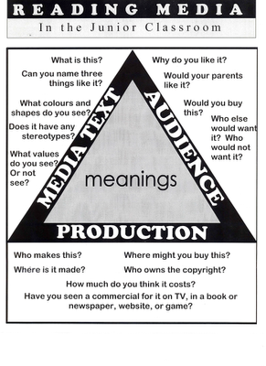
Three points of view
The media text (the message)
The audience
The production
All three must be analyzed to fully understand the meaning

Slide 11
Using the triangle to analyze text
Media Text:
What is this?
Name three things like it.
What values are promoted?

Slide 12
Using the triangle to analyze text
Audience:
Who is this for?
Do you like it? Why?
Would your parents like it?

Slide 13
Using the triangle to analyze text
Production:
Who makes it and why?
Where was it made?
Where might you buy/find it?
Have you seen a commercial for it?

Slide 14
Let’s analyze a few together

Slide 16
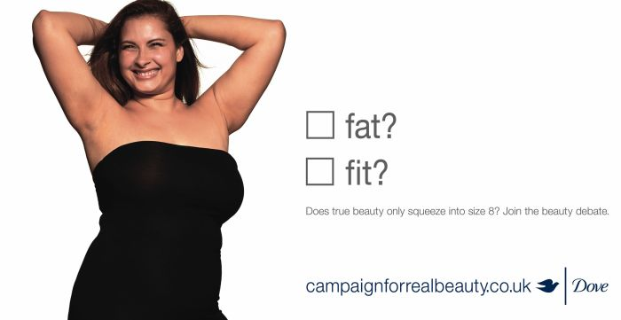

Slide 18
Advertisement Videos
https://www.youtube.com/watch?v=uGXr73qMqEs&spfreload=10

